Slide 1
EE418 Software Engineering Senior Design
Daqing (dar ching) Hou
Associate Professor
Director of Software Engineering Program

Slide 2

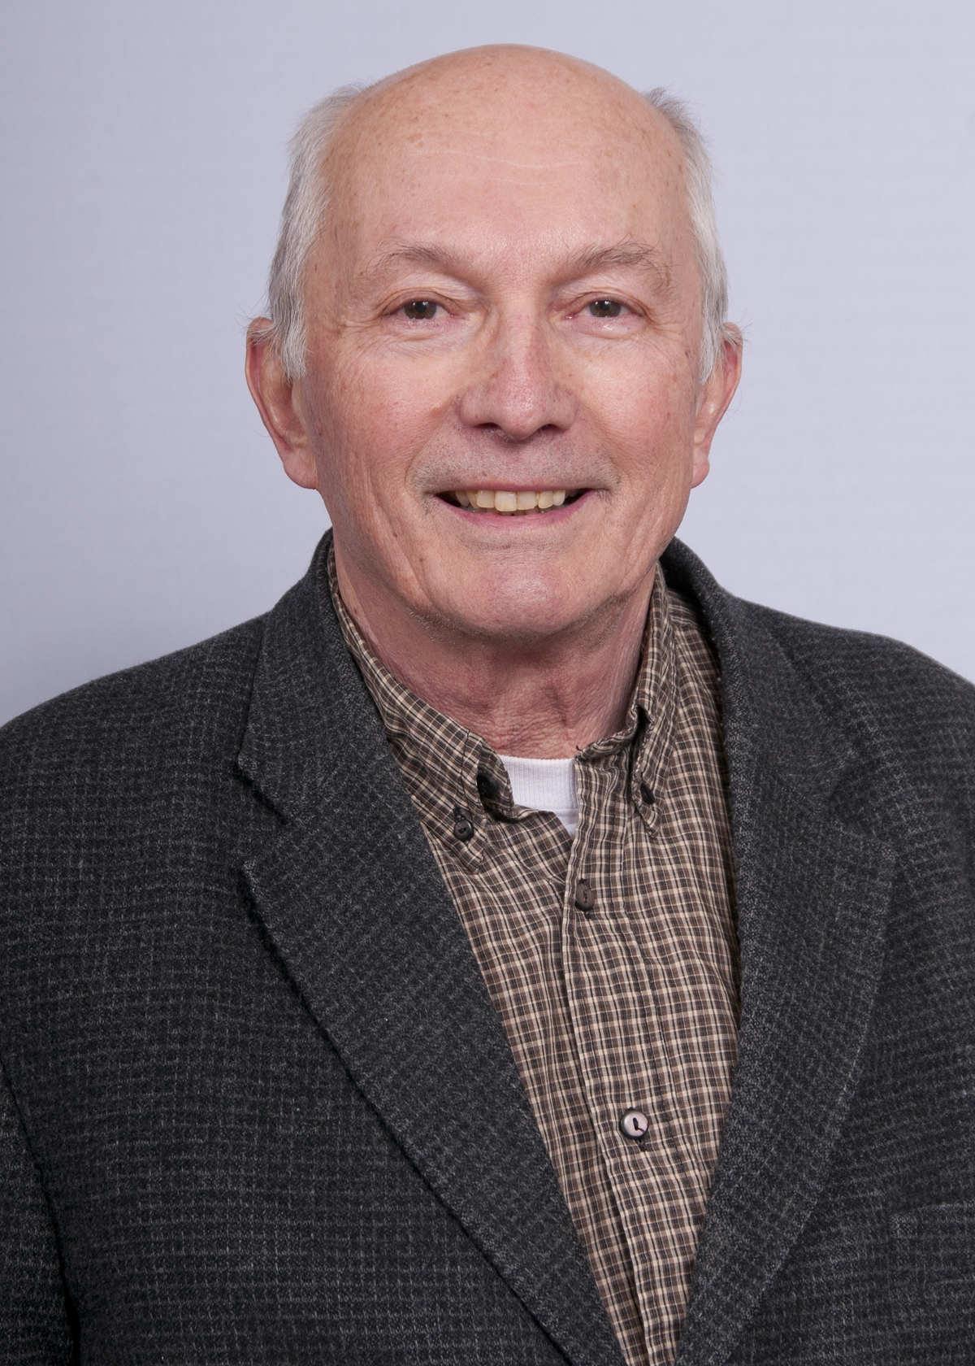
Required text Software Engineering: The Current Practice 1st Edition by Vaclav Rajlich (Author)
ISBN-13: 978-1439841228
ISBN-10: 1439841225
http://www.amazon.com/Software-Engineering-Practice-Innovations-Development/dp/1439841225

Slide 3
Official Course Description
Working in a team environment, students will design and develop a complex software system. Using sound software engineering techniques, the students will take conceptual ideas for a software system and turn it into a well-engineered product.

Slide 4
Course Structure
10-10:50 AM, Monday/Wednesday/Friday
Office hour: 1-2:15 PM, CAMP 127
Mix of lectures (Monday/Wednesday)
To introduce you to the state of art of team software engineering processes
And lab exercises (Friday)
To introduce you to relevant SE techniques:
Code repository (sharing code with team)
Programming environment
Project codebase setup
Code review
…

Slide 5
Grading Distribution
Approximately
Team project 50%
Homework/lab assignments 20%
Midterm exam 10%
Final exam 15%
Class participation 5%

Slide 6
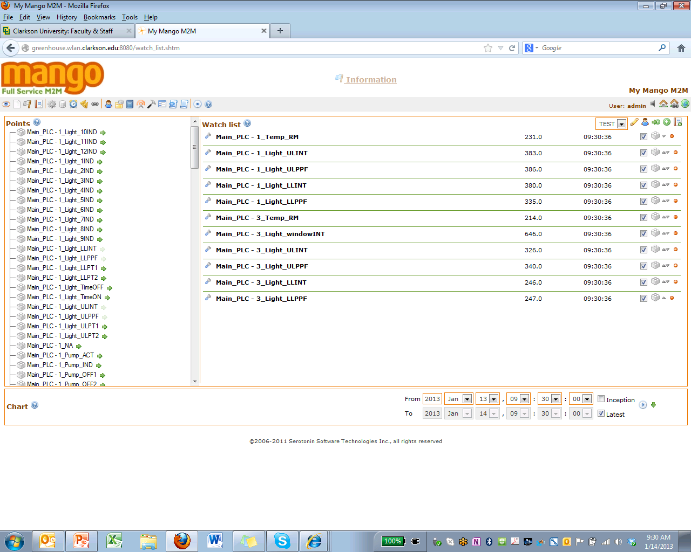
Web-based, Data Acquisition, Archiving, and Accessing
646
326
http://greenhouse.wlan.clarkson.edu:8080

Slide 7
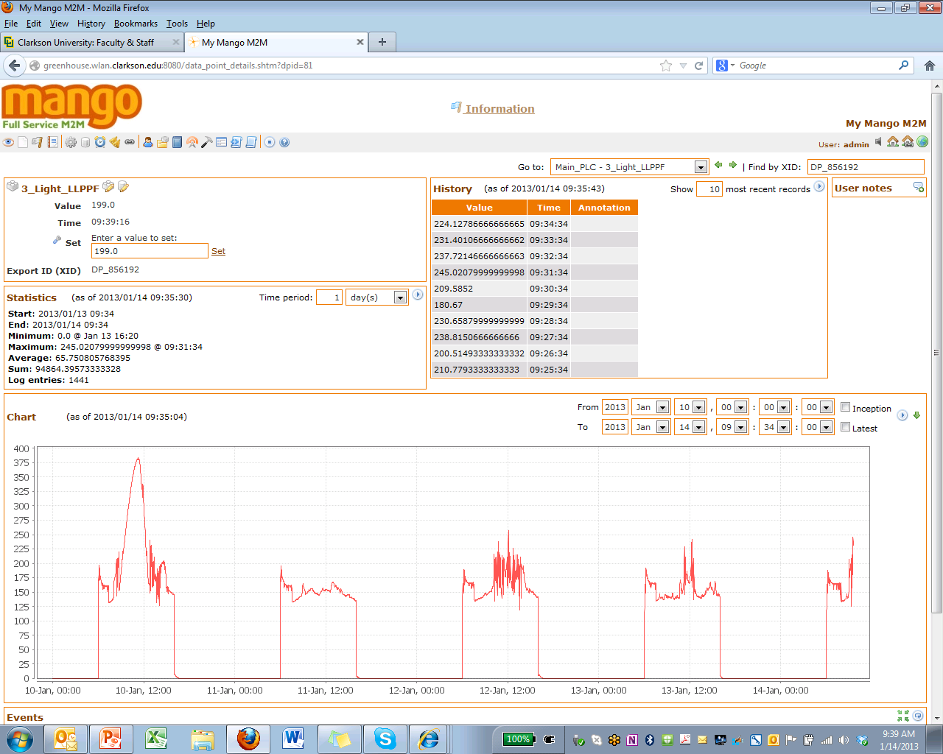

Slide 8
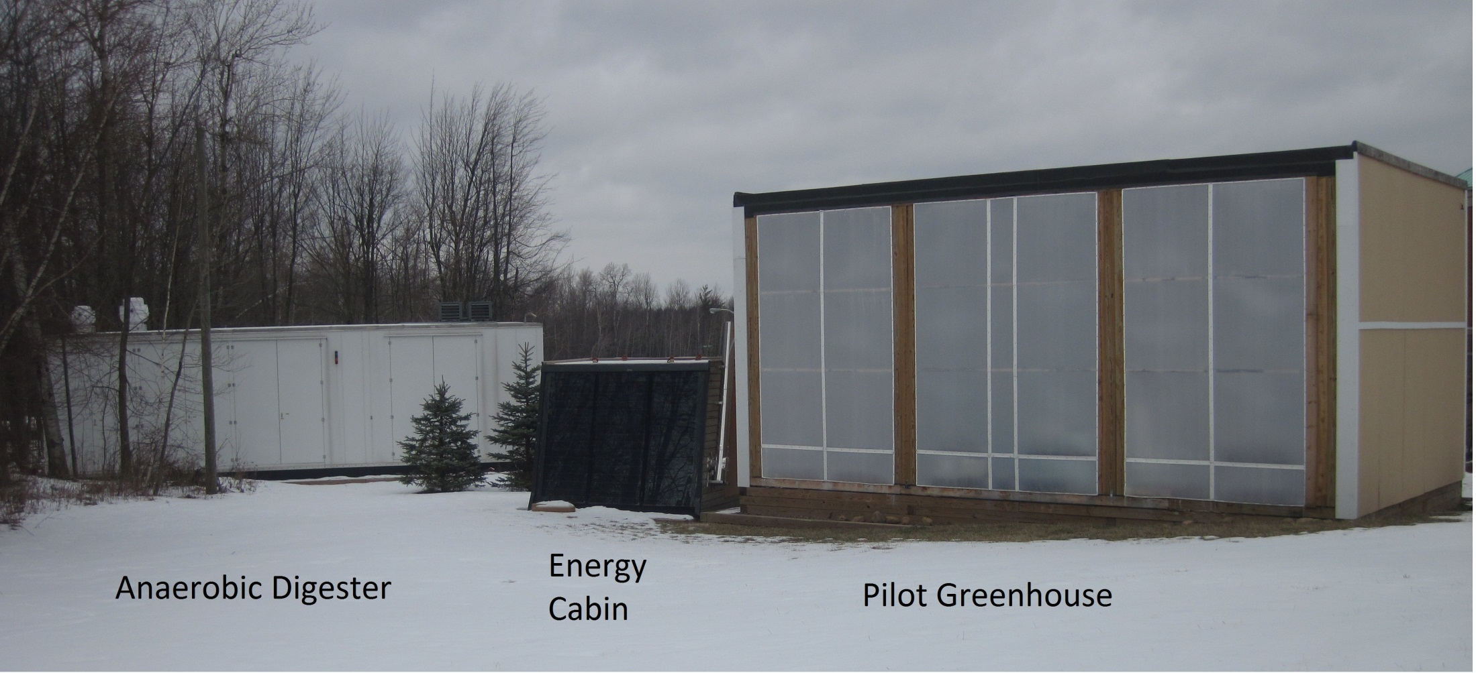
Integrated Food, Food Waste and Energy Production at Clarkson University

Slide 9
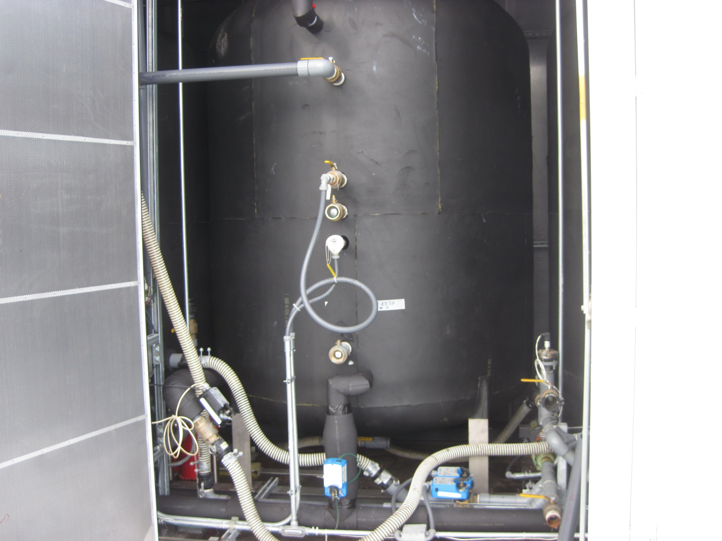
Anaerobic digester
650 lb food waste/day
Transformed into biogas
then electric and heat energy

Slide 10
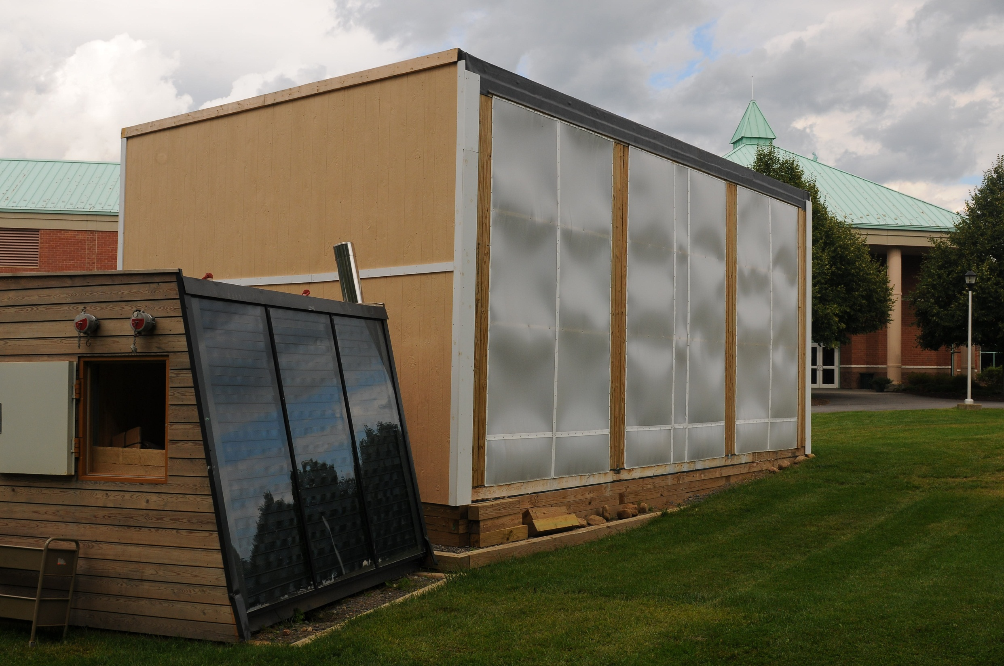
(September 2011)

Slide 11
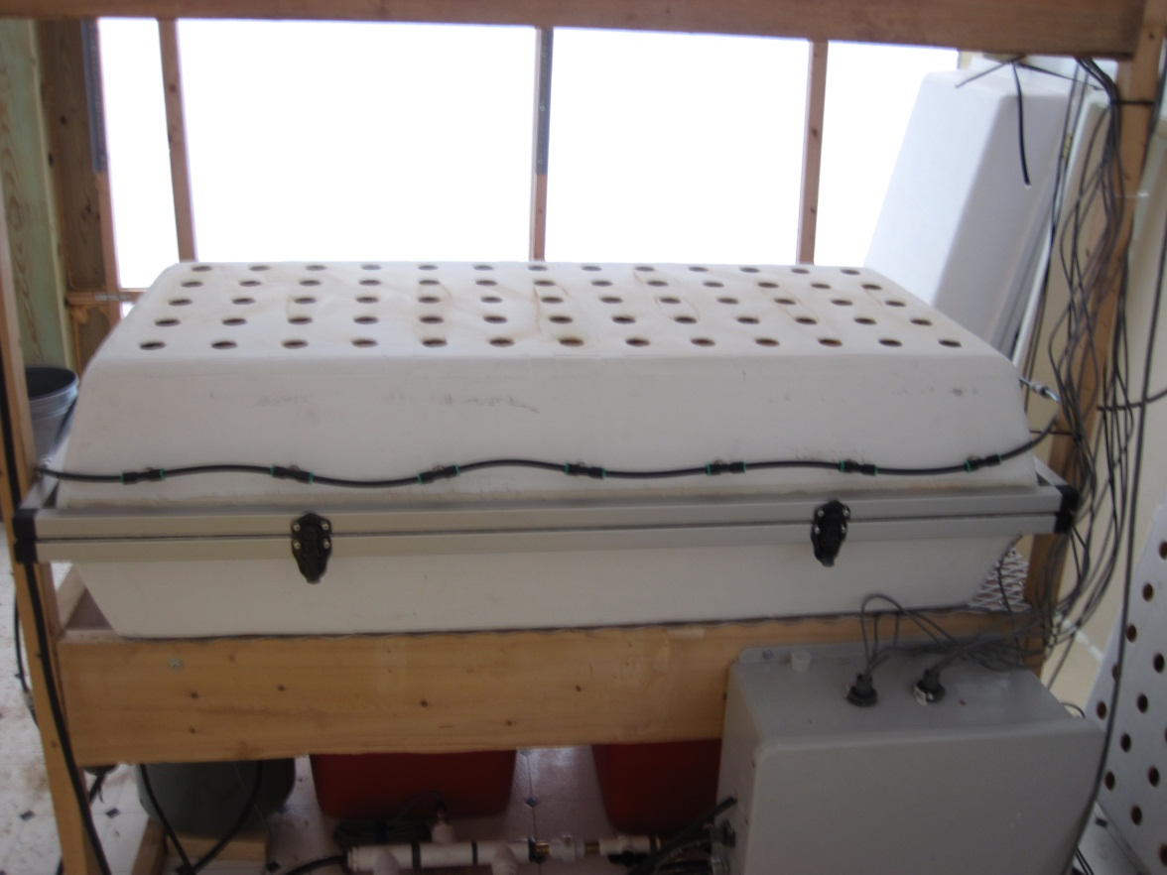
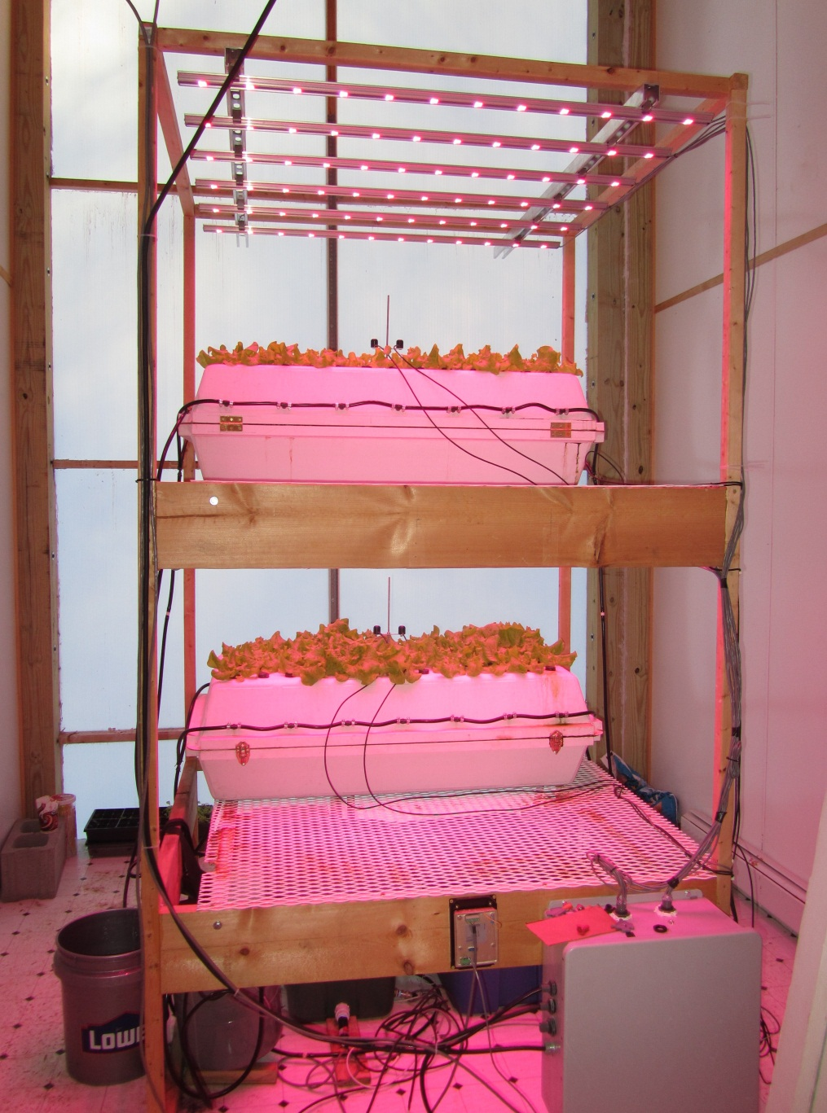
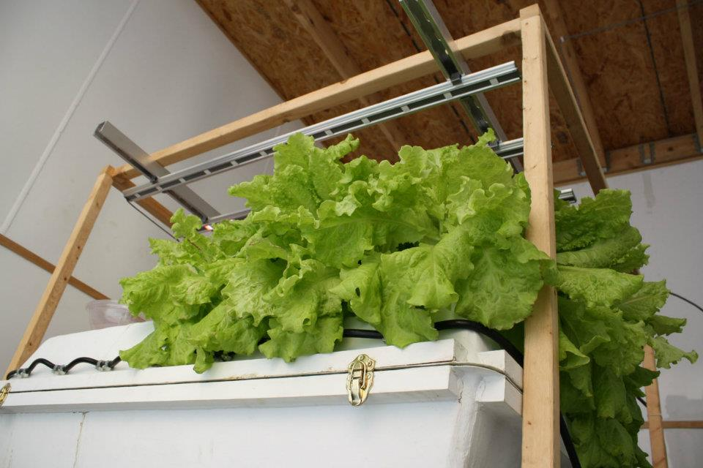
Aeroponic System

Slide 12
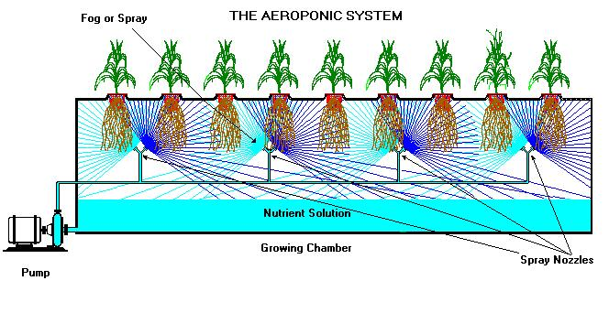
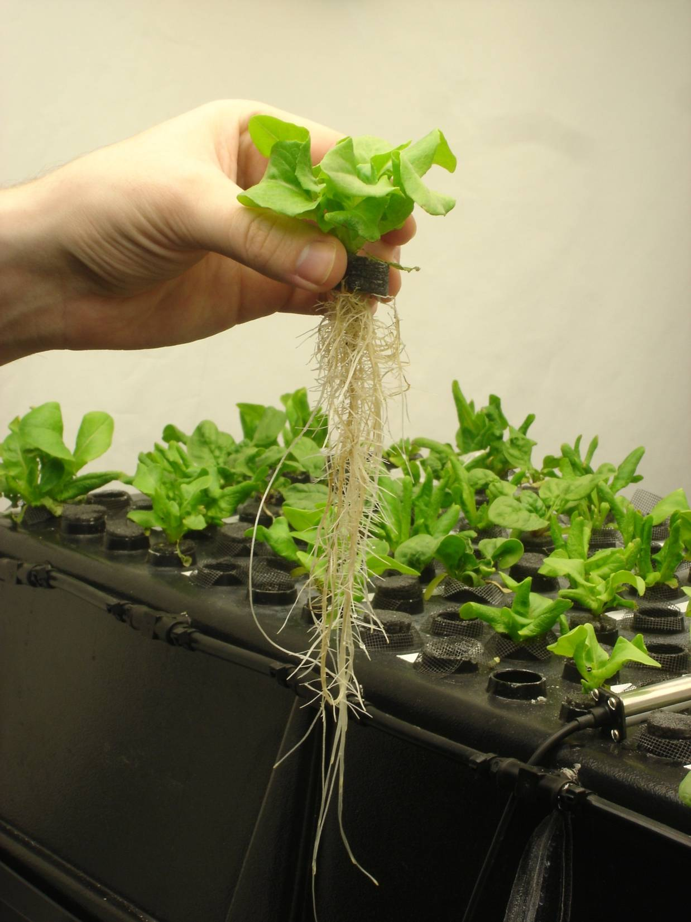
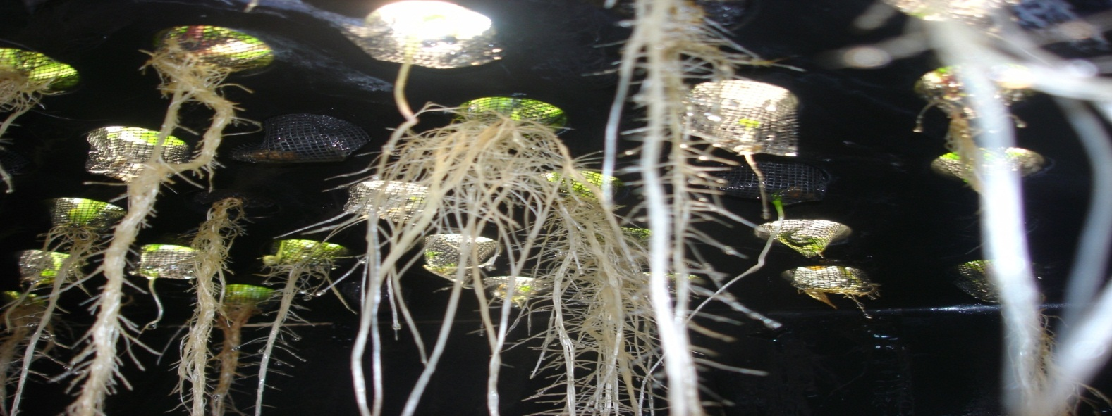
Phase I: Laboratory Testing and Feasibility Assessment
(AY2010)

Slide 13
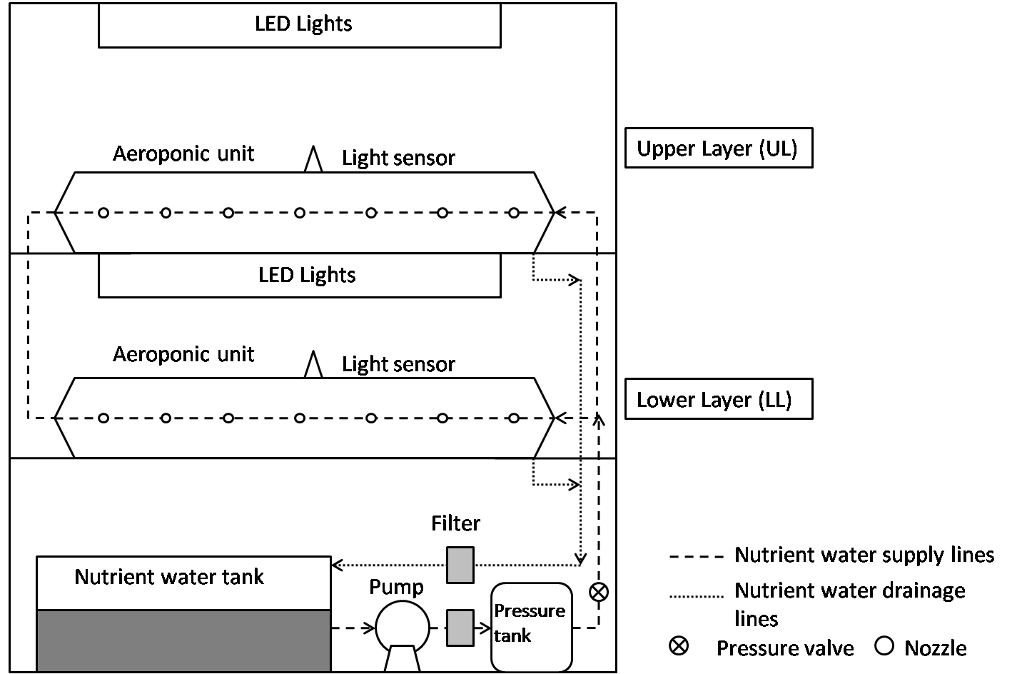
Aeroponic System
Aeroponic growing system with LED lights in Room 1 and Room 3

Slide 14
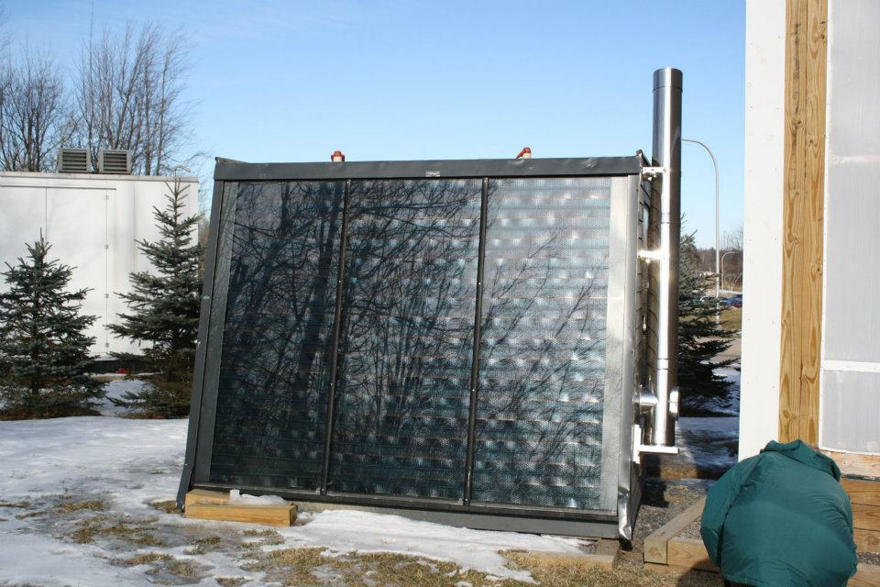
Heating System
Energy Cabin
European designed and built
Solar thermal hot water (2 kW)
Wood pellet boiler (20 kW)

Slide 15
Heating System
Solar gain substantial
Hot water/glycol (T ~80°C) Pumped from Energy Cabin
3 supplemental pumps in GH distribute HW to rooms
T independently controlled in each room
To/from AD
Energy Cabin

Slide 16
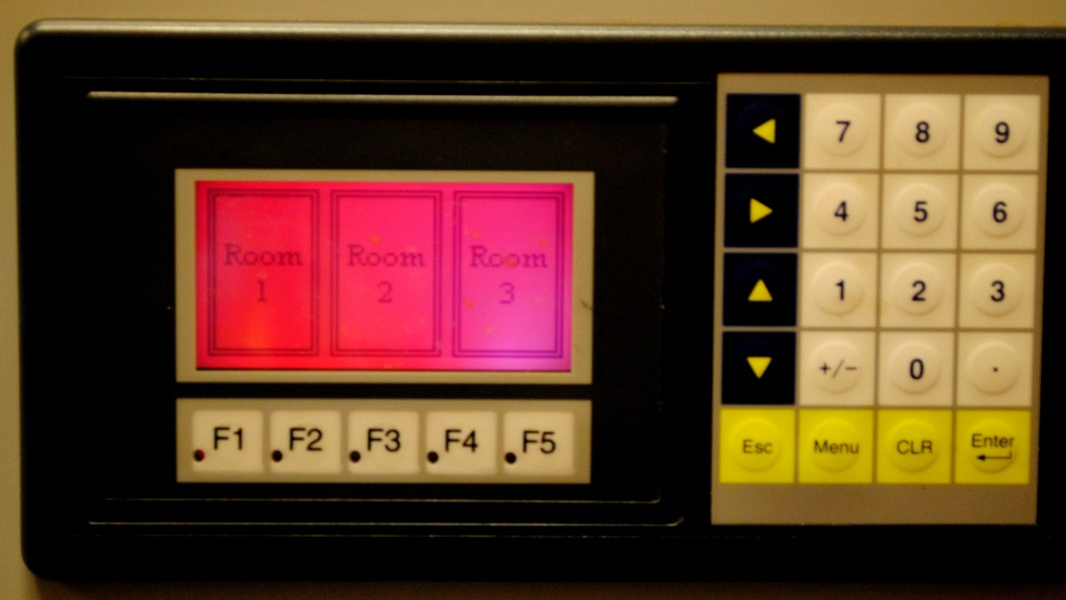
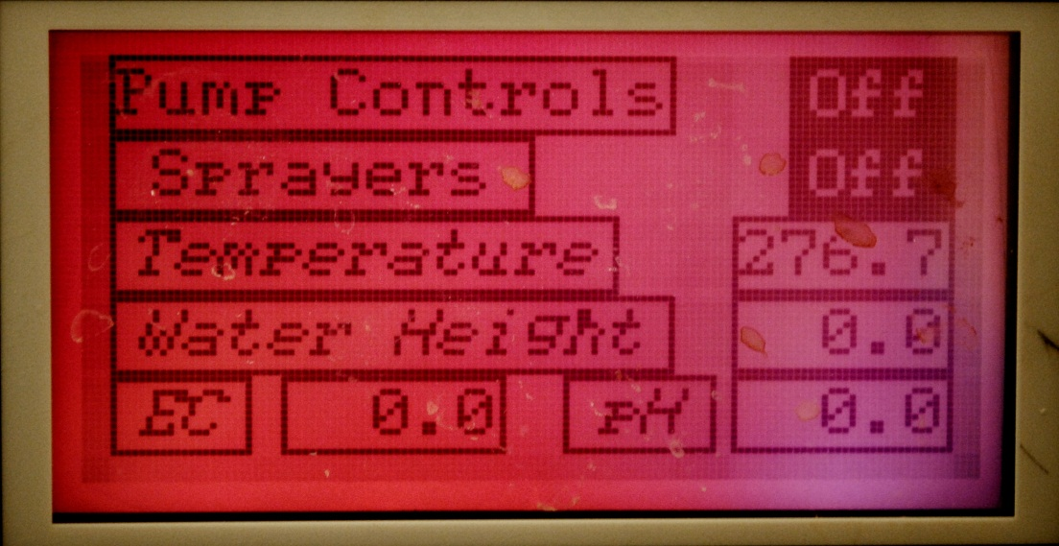
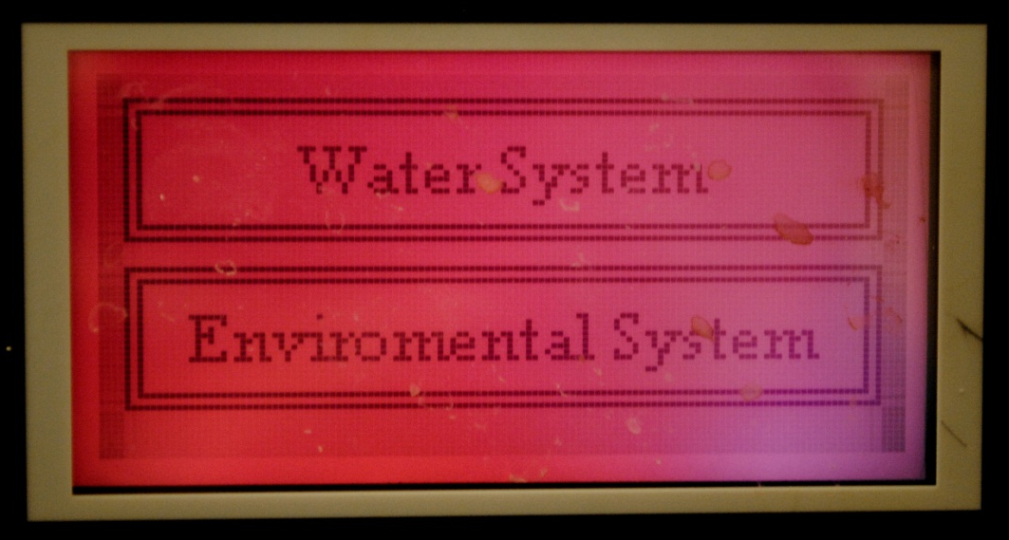
Control System
Program logic controller (PLC) connected to all 3 rooms
Frequency of spraying
Lights on/off
Temperature
Other possibilities
Water tank volume
pH

Slide 17
Data Acquisition and Archiving
646
326
http://greenhouse.wlan.clarkson.edu:8080

